Slide 1

Data Warehouse Final Project: Car Sales
Presented by:
Meryem Abdallah
Othmane Atanane
Yassir Benabdallah

Slide 2
Agenda
1. Introduction
2. Requirements
3. Design and Architecture
4. BI Tools
5. Implementation
6. Data Visualization
7. Conclusion

Slide 3
Introduction
Company Overview
Koulchi’Isog
Its primary activities include the import, purchase, and sale of new and used automobiles
Problem statement
Koulchi’Isog noticed a drop in its sales,
The analysis should give the company an idea of the reasons behind that drop
Project Objective

Slide 4

Requirements

Slide 5
Requirements Gathering
Make the data warehouse updated regularly, preferably on a daily basis.
Examine the sales performed in different branches, cities, and time frames.
Have an idea about how the human resources (salespersons) are performing.
Generate a recommendation system based on the purchase patterns of each customer

Slide 6
Requirements Spesification
The data warehouse should extract data from a database of the Kolchisog agencies.
The data brought from the databases should be cleaned and structured before being uploaded to the data warehouse.
The data warehouse should contain all the information related to car sales, by the corresponding agency, to a client, on a specific date.
The data warehouse should be updated daily.
The data warehouse should be queried by the users using a tool with an easy-to-use interface.
The user shall be able to generate reports in standard formats such as pdf and excel.
The user shall be able to dynamically switch back and forth from high levels of details to summarized views.

Slide 7

Design Architecture

Slide 8
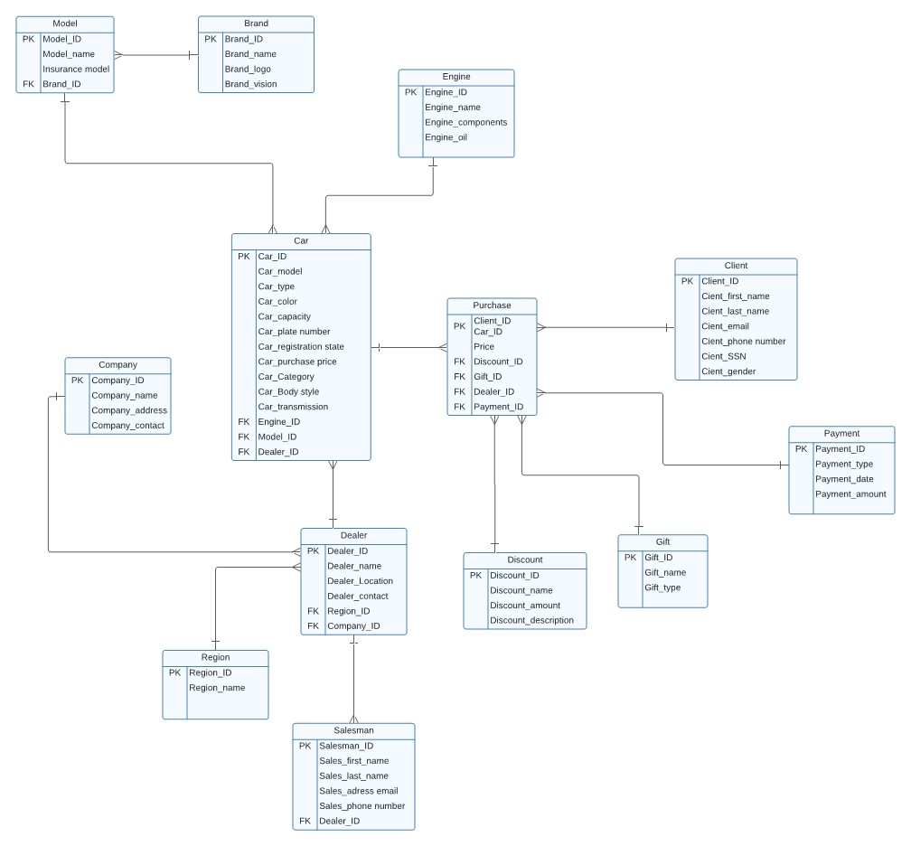
Operation DB Design

Slide 9
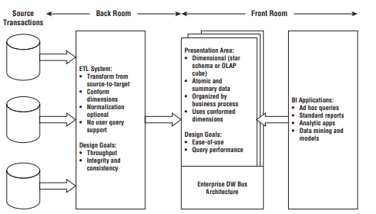
DW Architecture

Slide 10
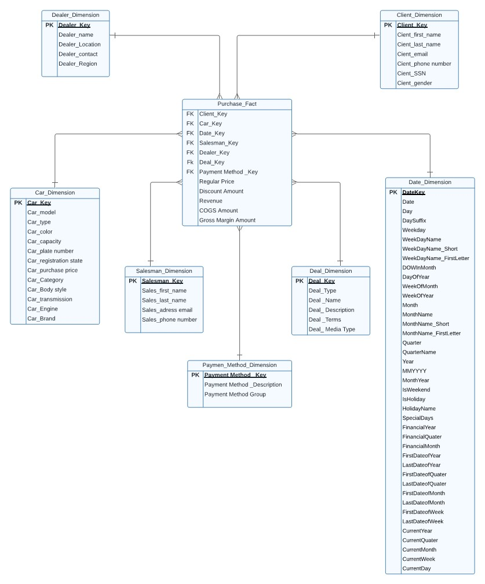
DW Dimensional Design

Slide 11

Implementation

Slide 12
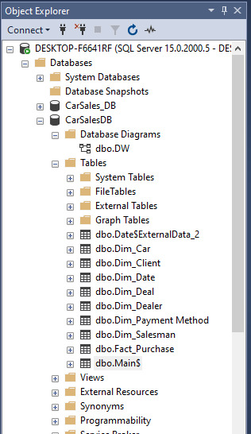
Star Schema Implementation

Slide 13
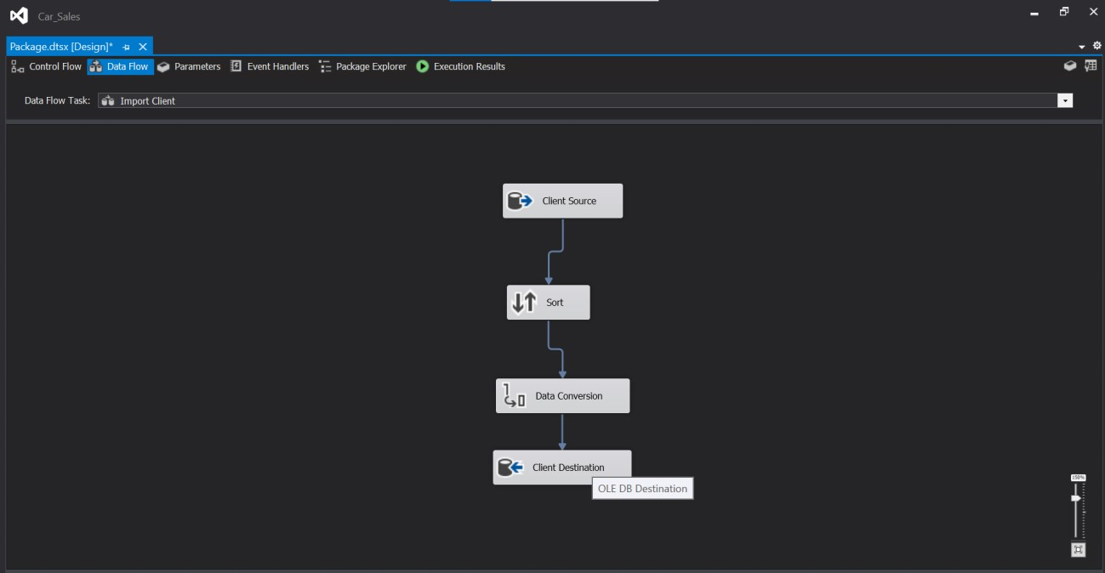
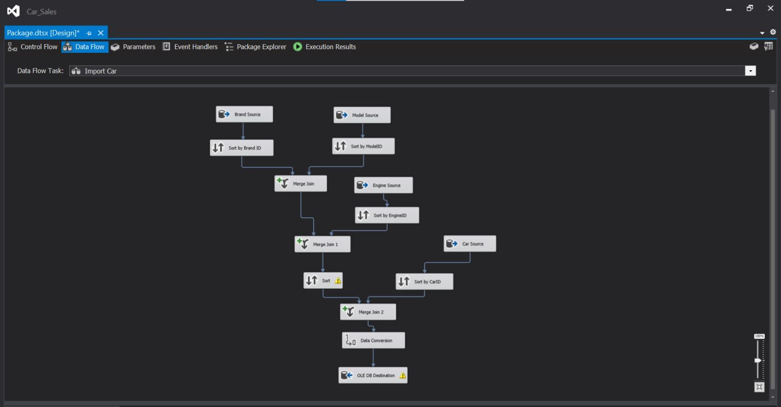
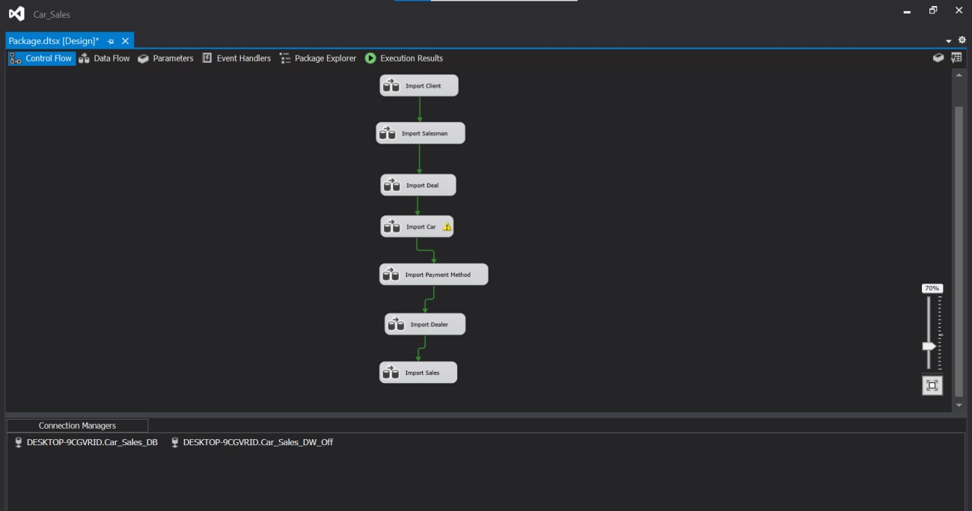
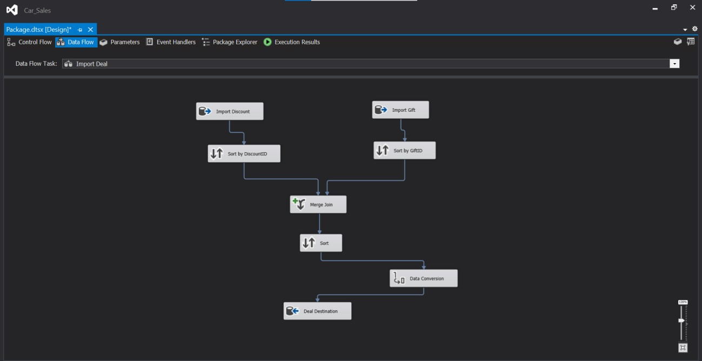
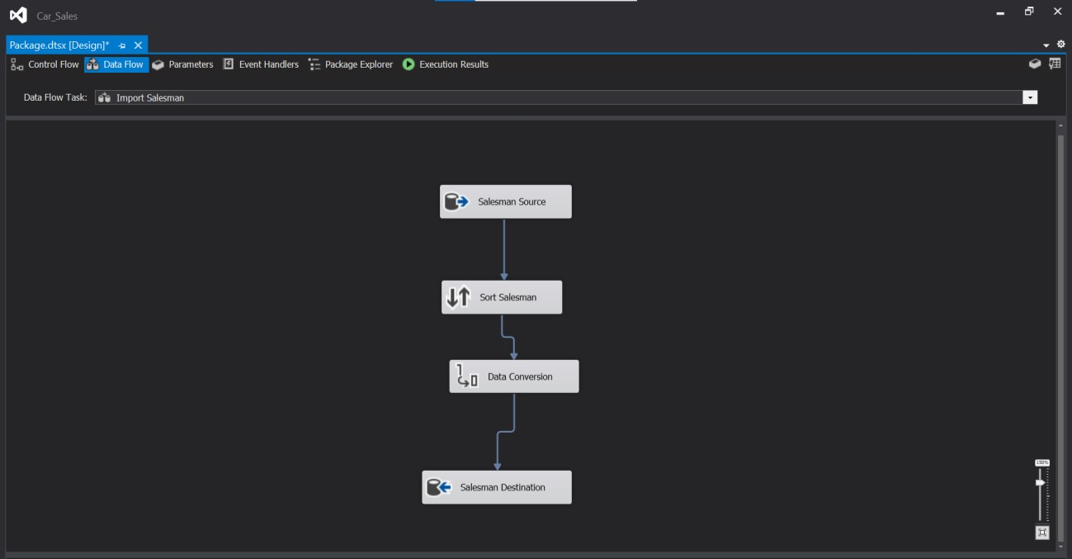
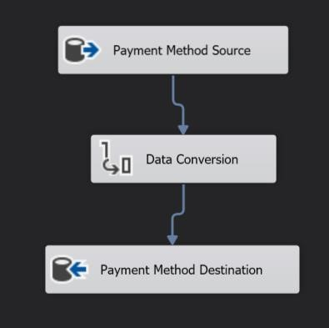
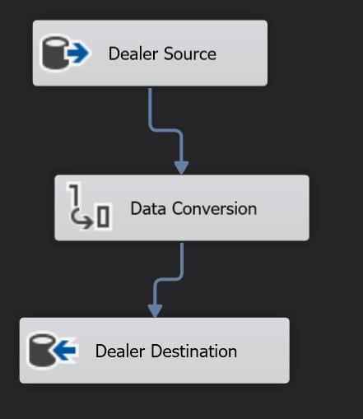
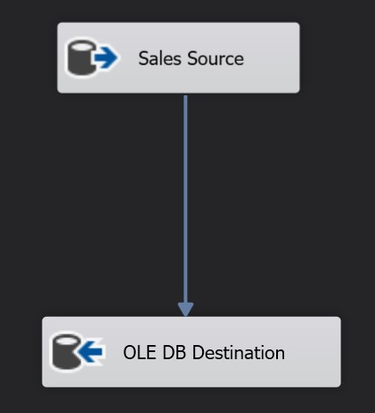
ETL System

Slide 14
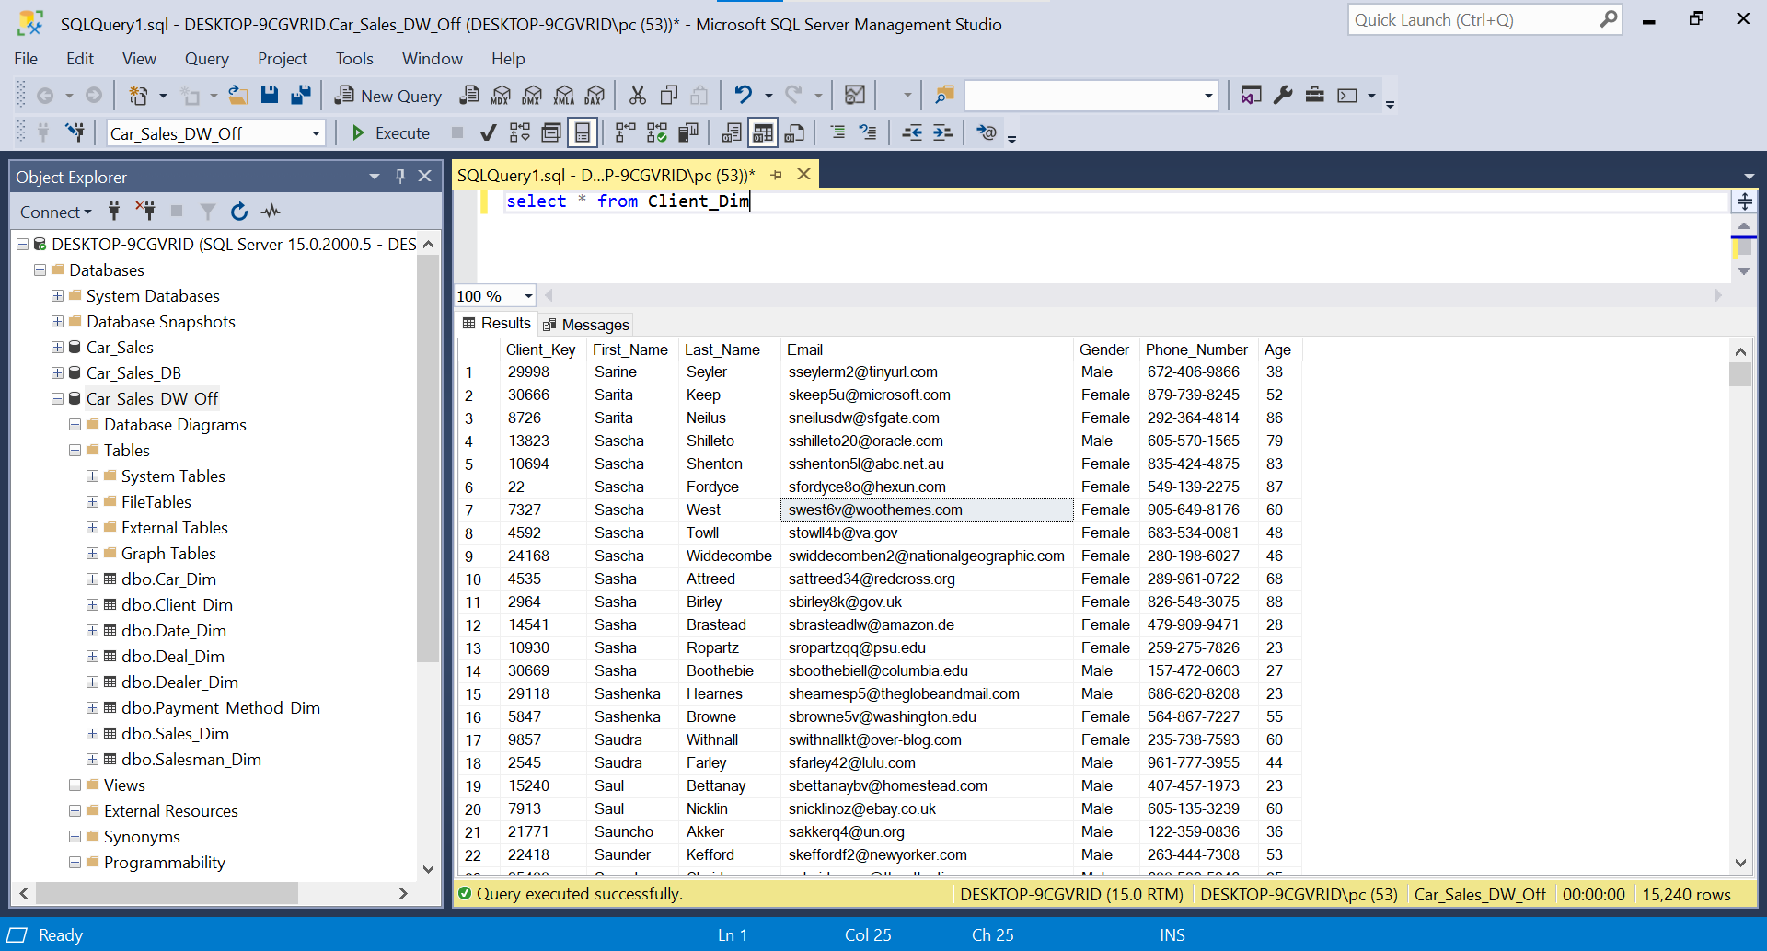
Population of Star Schema Using ETL

Slide 15
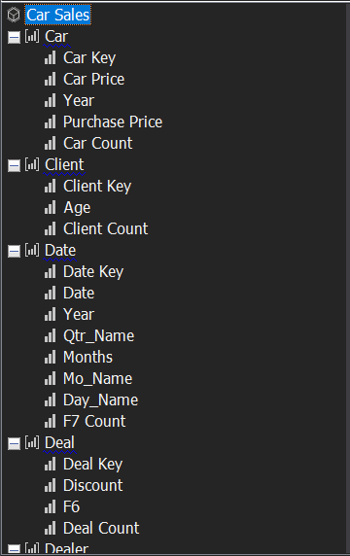
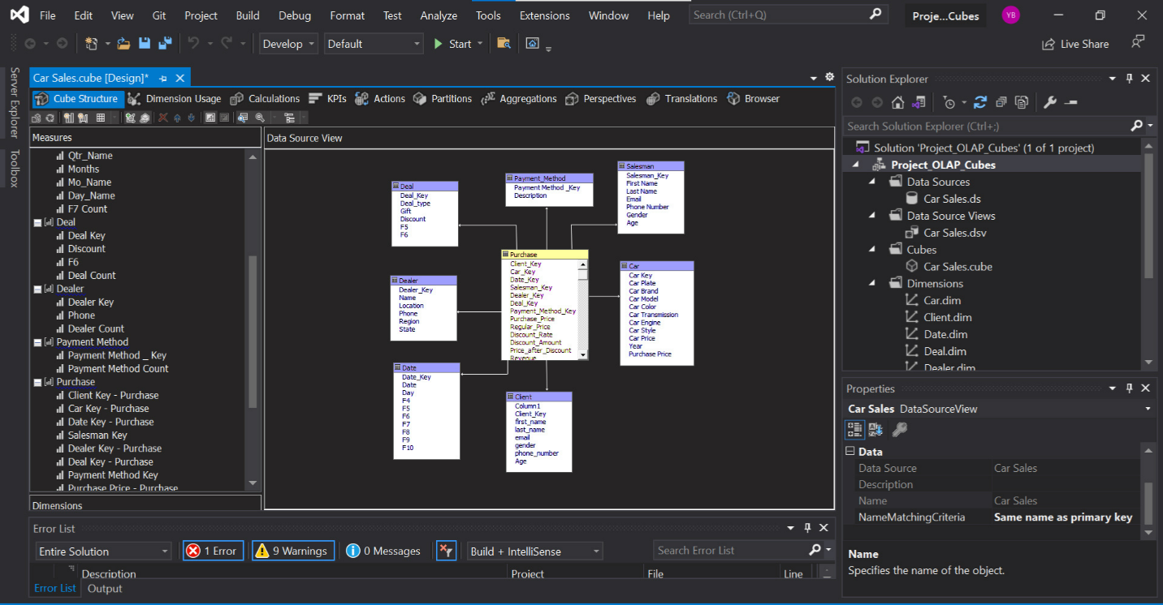
OLAP Cube Implementation

Slide 16

Data Visualization

Slide 17
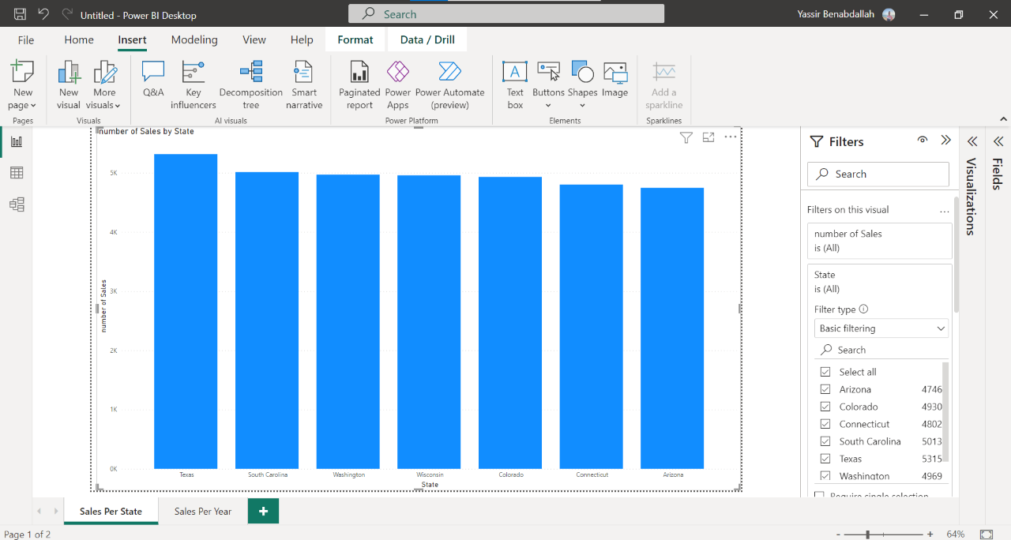
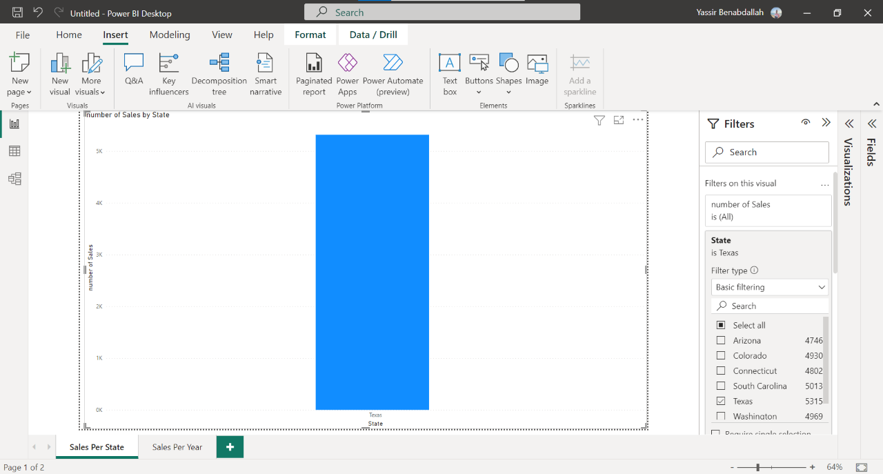
Sales Based on Location

Slide 18
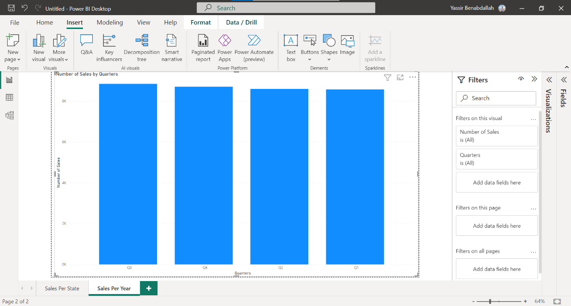
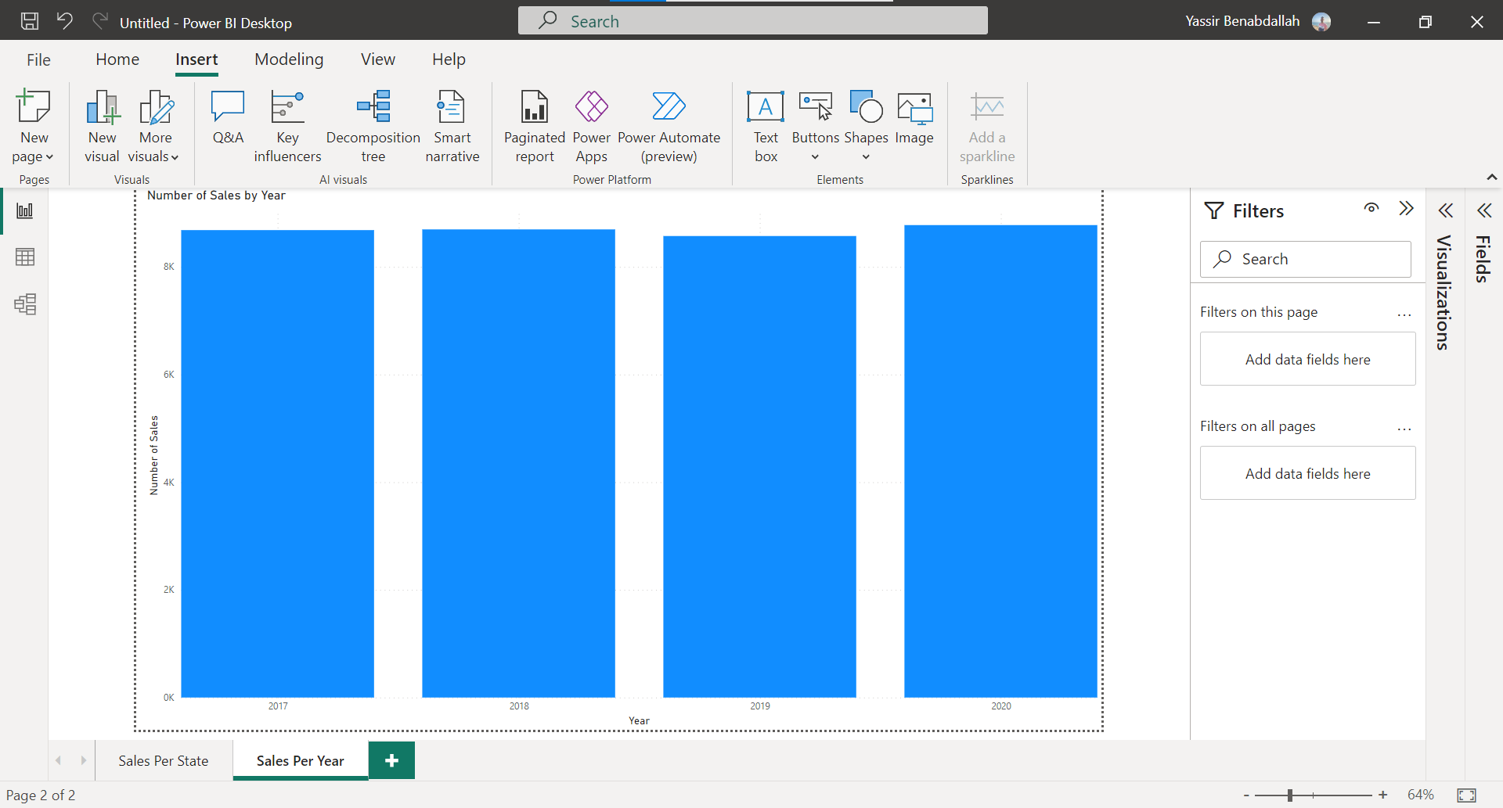
Sales Based on Date

Slide 19
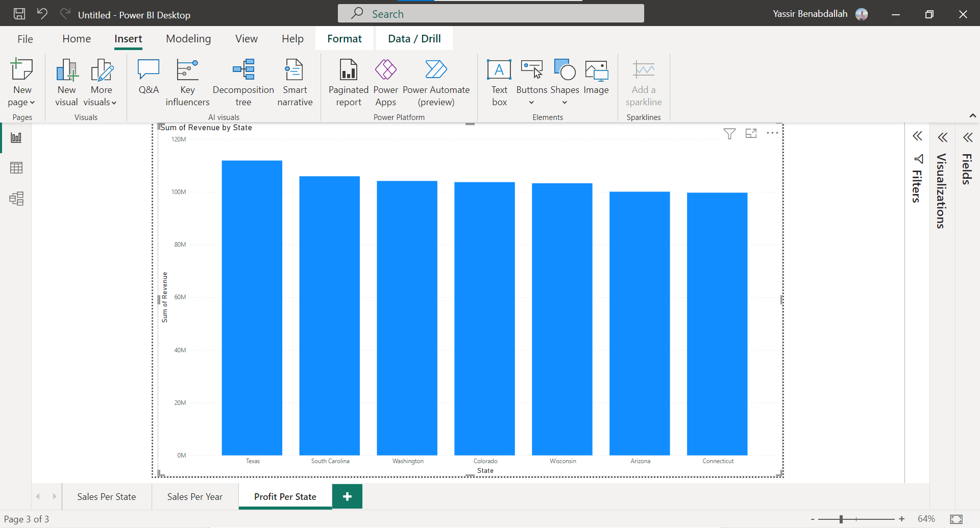
Revenue Per Location

Slide 20
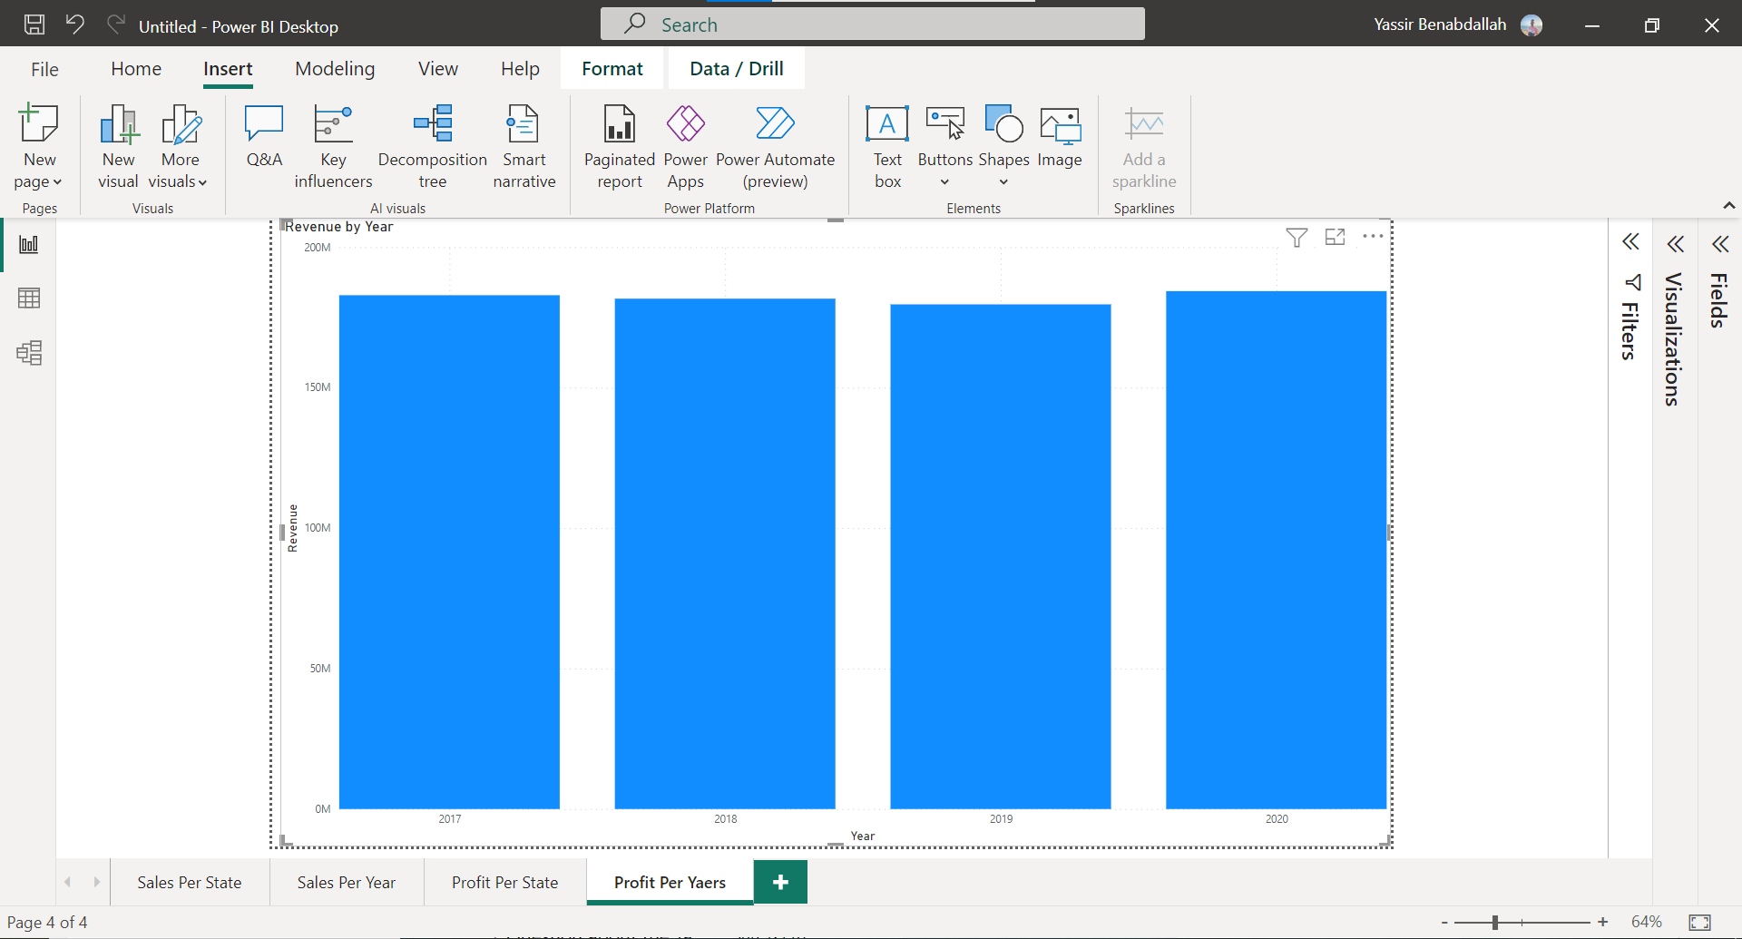
Revenue Per Date

Slide 21

Conclusion

Slide 22

Thank You!

